Slide 1

Citing Right . . .
Frustrations and Solutions for Better Cite Checking and Footnotes.

Slide 2

Frustrations
Staff members
Editors
Authors
Student Writers

Slide 3

Staff Members’ Frustrations
“Why am I doing this grunt work?”
“There’s too much to do!”
“I can’t find the rule!”
“I’ve found the rule, but still can’t figure it out!”

Slide 4

Training new members is key.

Slide 5

“Why am I doing this grunt work?”
Emphasize the substantive check.
Explain importance -- to the law review -- of ensuring that the substance is valid and correct.

Slide 6

“Why am I doing this grunt work?”
Plagiarism can cause embarrassment.
Professors do not always put enough time and effort into footnotes.
  Time pressures
  Attitude
  Student assistants

Slide 7
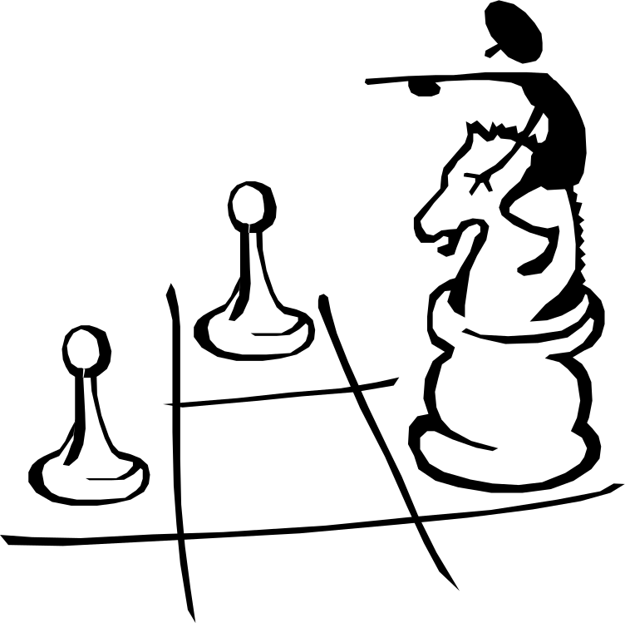
“There’s too much to do!”
Break down the steps.
Provide a checklist (samples in packet).
Start with smaller assignments.
Better coordinated assignments.
Involve librarians.
Ask authors for sources.

Slide 8

“I can’t find the rule!”
Training sessions on how to use the ALWD Manual or Bluebook.
Analogize to a statute.

Slide 9

“I’ve found the rule, but still can’t figure it out!”
Examples in citation manuals may not always answer the question.
Current issues of your review?
Editor office hours?
Communication system.

Slide 10

Editors’ Frustrations
We trained the staff, but they still make a lot of mistakes!
  Facial mistakes.
  Other mistakes.

Slide 11

Solutions
Continued training.
  All hands meetings.
  Staff motivation.
Feedback
  Individual (quickly).
  Newsletter or e-mail to group about common errors.
Spot checking.
  Cite and source collections.
  West KeyCite.

Slide 12

Authors’ Frustrations
Changes, changes, and more changes.
Incorrect changes.
Where are the changes?

Slide 13

Solutions
Avoid change for the sake of change.
Give author your citation policies.
Have an editor check the citations before the galley goes to the author.
Redline changes?
Communicate.

Slide 14

Student Writers’ Frustrations
Student writers often do not know how to use footnotes.

Slide 15

Again, training and feedback are key.

Slide 16

QUESTIONS???

